Slide 1
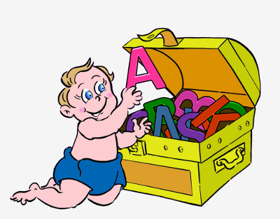
First Language Acquisition

Slide 2
First language acquisition refers to the acquisition of the capacity to perceive and comprehend language, as well as to produce and use words and sentences to communicate and reason.
The study of language acquisition is fascinating, important and complicated.
- enormous interest in this process
- enhancing our understanding of language as a whole / many applications
- enormous difficulties encountered in the research

Slide 3
contents
Language environment
Stages of language acquisition
Development of different aspects of language
- Phonological development; morphological development; syntactic development; semantic development

Slide 4
Language environment
Contact with a particular language
- immersed in a language-rich environment
Interactions with other language users
- Language stimuli themselves are not sufficient.
- The interactions with other language users (e.g. caregivers) are important.

Slide 5
Caregiver speech
We do not interact with babies as we do with adults.
Baby talk
Caregiver/caretaker speech, infant-directed speech (IDS), child-directed speech (CDS) or motherese
How do you speak to a very young child? (Characteristics of baby talk)

Slide 6
Caregiver speech
mother: Look!
child: (touches pictures)
mother: What are those?
child: (vocalizes a babble string and smiles)
mother: Yes, there are rabbits.
child: (vocalizes, smiles looks up at mother)
mother: (laughs) Yes, rabbit.
child: (vocalizes, smiles)
mother: Yes. (laughs)

Slide 7
Stages of language development
Stage 1: around the birth
Language acquisition begins prior to birth and continues after birth.
Newborns are sensitive to speech sounds.

Slide 8
Stages of language development
Stage 2: Cooing (around 4-6 Months Old)
Speech production: producing very basic, isolated vocalizations
Speech perception: discriminating some basic vowels and syllables

Slide 9
Stages of language development
Stage 3: Babbling (around 7-11 Months Old)
Speech production
- producing a number of different vowels and consonants
- producing more syllables
- producing chains of identical syllables (e.g. ba-ba-ba, du-du-du, ga-ga-ga)
- producing chains of different syllables (e.g. ma-da-ga-ba)
- Sounding that babies are speaking an ‘alien language’.
Speech perception
- recognizing tones of voice

Slide 10
Stages of language development
Stage 4: The one-word stage (around 12-18 Months Old)
one-morpheme or one-unit stage or holophrastic stage
Children speak mainly in single words.
- naming objects (e.g., “milk,” “cookie,” “cat,” “cup” and “spoon”)
- likely to refer to more complex situations (e.g., saying "milk“ rather than "I want milk”; saying “daddy” while pointing dad’s shoes)

Slide 11
Stages of language development
Stage 5: The two-word stage (around 18-24 Months Old)
Two distinct words are used together.
- usually lacks function words
- usually lacks inflectional morphemes
- the two words could have a number of possible relations.
e.g. Daddy car, hit ball, etc.
- perception goes before production

Slide 12
Stages of language development
Stage 6: Telegraphic speech
Usually function words and morphemes are missing (to, the, can, is,etc.).
- this shoe all wet, cat drink milk and daddy go bye-bye
Then,
The child’s vocabulary is expanding rapidly;
Function words and inflectional morphemes begin to appear more regularly;
Clearer in pronunciation and better in grammar;

Slide 13
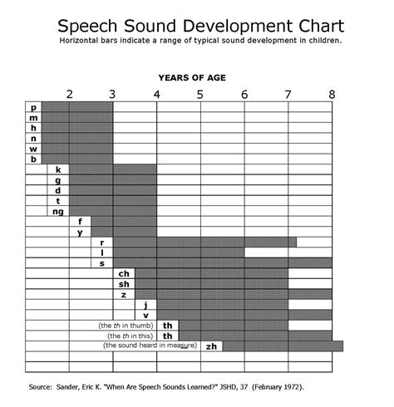
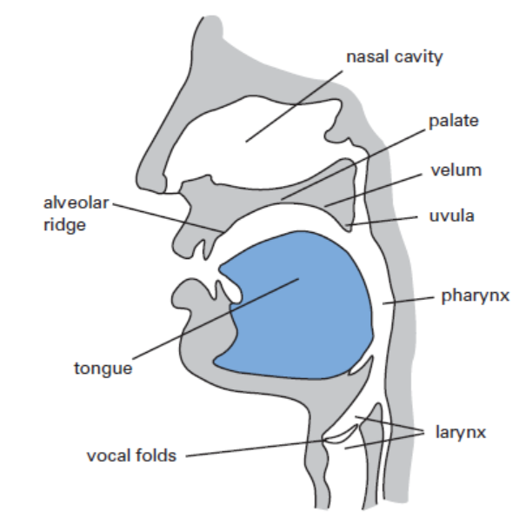
Phonological development
General trend in the order in which children use consonants
1. Labials ([p], [b], [m])
2. Alveolars ([t], [d], [n], [s], [z], ] [l], [r])
3. Velars ([k], [g], [ŋ])
4. Alveopalatals ( [ʃ] [ʒ] [ʧ] [ʤ])
5. Dentals ([θ] [ð])
Why this general trend?

Slide 14
Phonological development
An interesting question
In some languages, two phones are allophones of the same phonemes (e.g., /t/ in tar and star; /i/ in be and bean);
In some other languages, these same two phones are two different phonemes (e.g., Thai).
Therefore, children have to learn whether two phones are allophones or two phonemes.
How do children learn this?

Slide 15
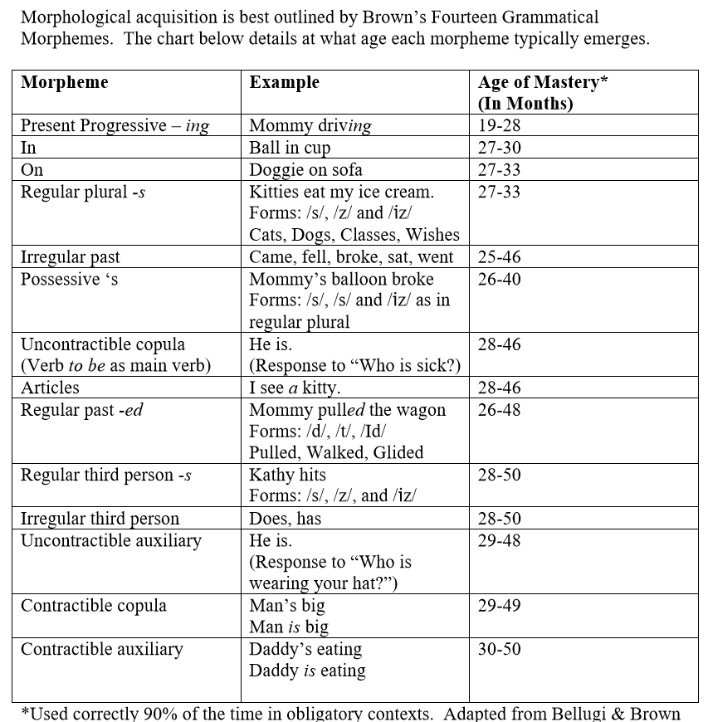
Morphological development
The time some morphemes in English typically emerge
Why this order?

Slide 16
Morphological development
Allomorphs: morphemes with different sounds or spellings but carrying the same meaning or serving the same grammatical function
Regular plural form and irregular plural form
Irregular past and regular past
Regular third person and irregular third person
The acquisition of these morphemes is often accompanied by a process of overgeneralization.
Children will typically overgeneralize the regular rules of adding –s or –ed.
- foots, mouses, sheeps, …
- knowed, eated, gived, goed, bringed, …

